Slide 1
BATON SIMULATIONS
ERPsim Online
Train-the-Trainer
Module 6: ERPsim Public Sector
Section 4

Slide 2
This module covers
Introduction to the Public Sector Scenario
DAS & 1909 Overview Tiles
The Fiori Launchpad
Facilitating Public Sector Events Instructional Tips & Tricks
Debriefing Public Sector

Slide 3
1.
ERPsim Public Sector
Overview
Built on top of the S/4HANA Public Sector Industry solution
Participants main goal is to help a community avert disaster and therefore gain social sentiment.
As a disaster relief team, working alongside other disaster relief teams, the job is to budget, procure and allocate relief products and services, taking into account the evolving needs of the community.
Participants begin the process with the most fundamental elements: allocation and procurement.
In the second round, they are introduced to funds management.
Objective
Help participants learn the fundamentals of SAP navigation and experience the dynamic operation of SAP in a full cash-to-cash process.
Requirements
Approximately 3 to 8 hours to conduct a session
Updated web browser and decent bandwidth
NO SAP KNOWLEDGE REQUIRED!

Slide 4
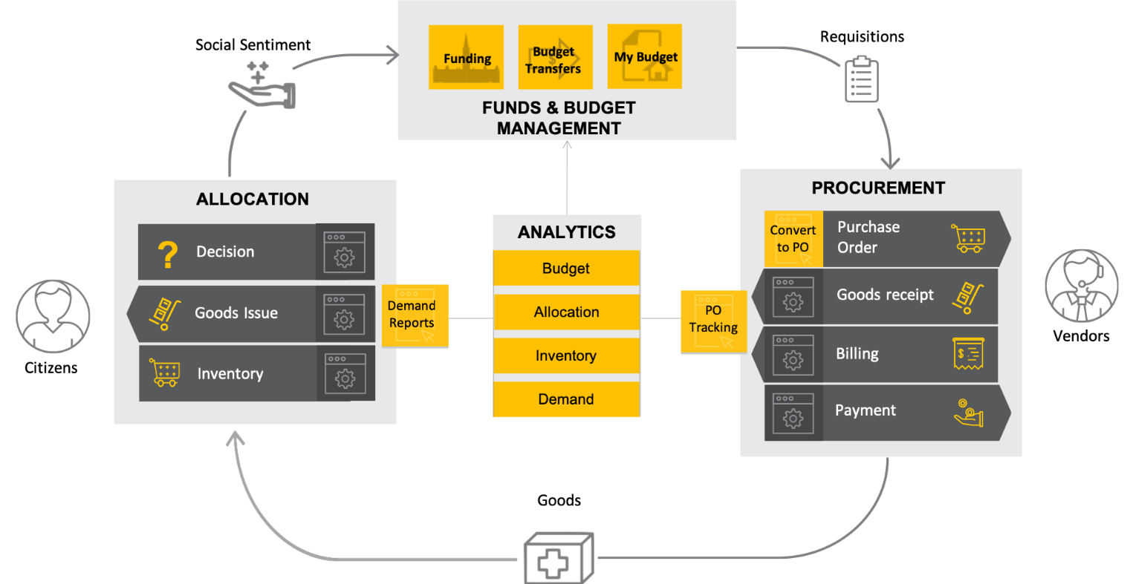
1.
ERPsim Public Sector
Overview of Processes

Slide 5
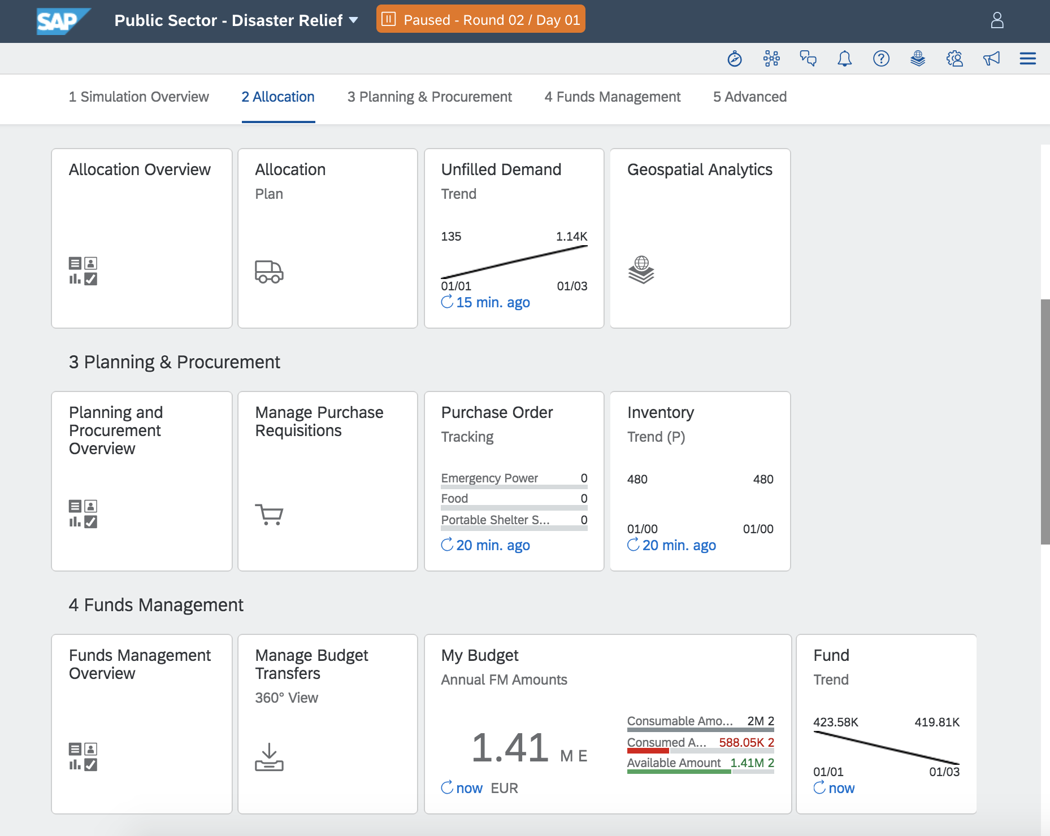
1.
Setup
Rules & Warehousing
Setup:
2 minute/virtual day
10 days/round
3 rounds/game
3 regions
1 distribution channel
6 product and services to distribute
$1 000 000 budget per round
Warehousing costs: Incurred when teams keep goods in inventory:
Sandbags: $150/day
Food: $400/day
Water: $200/day

Slide 6
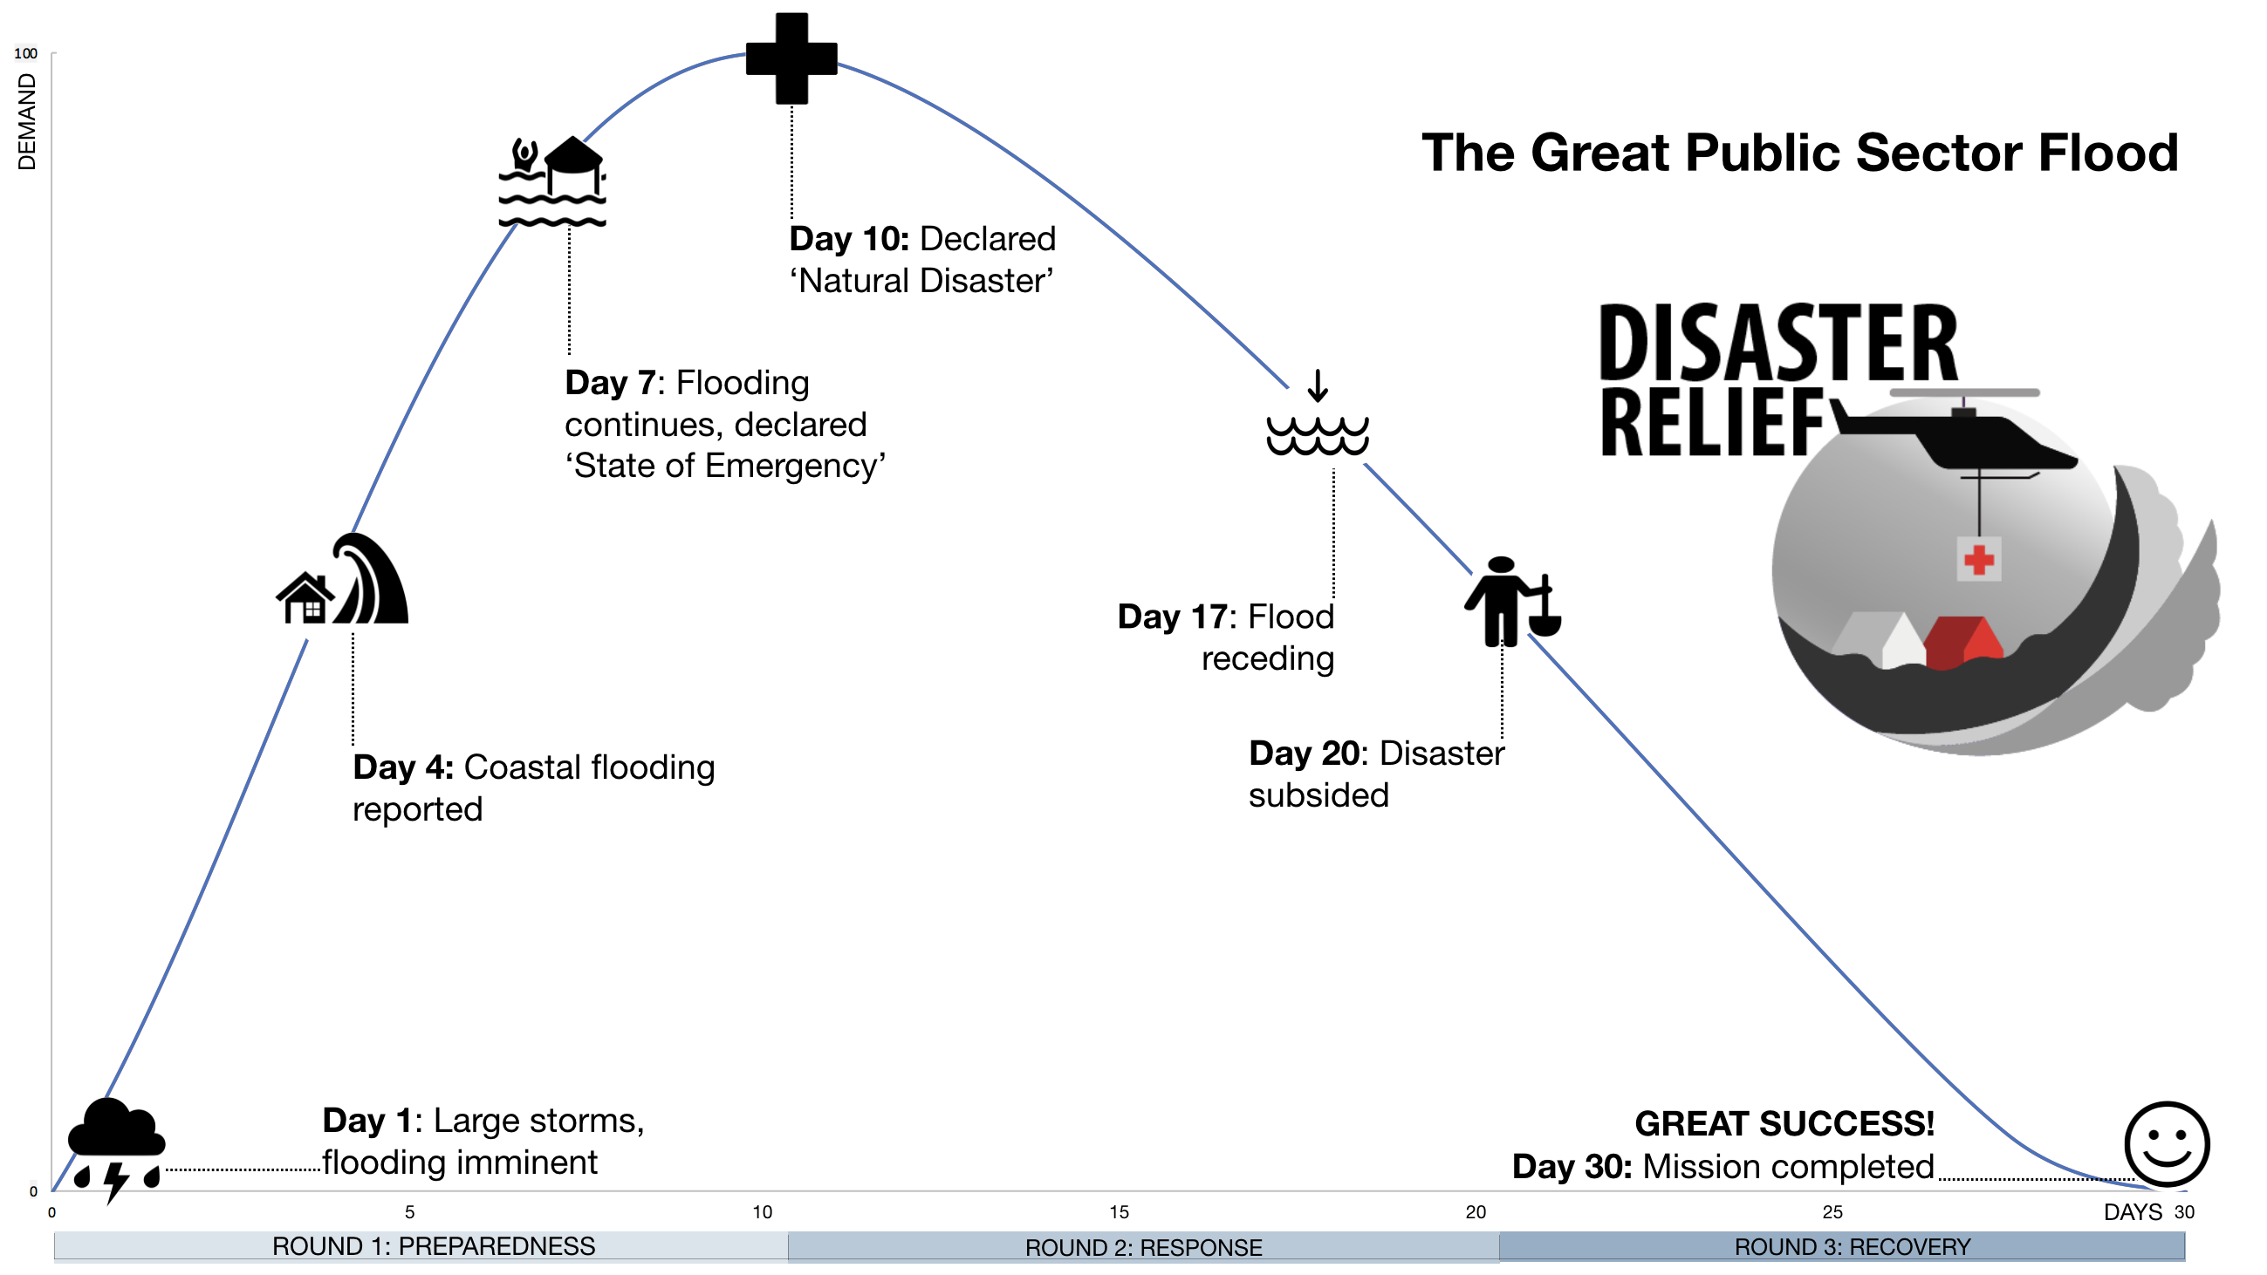
1.
Storyline
Setting the Scene

Slide 7
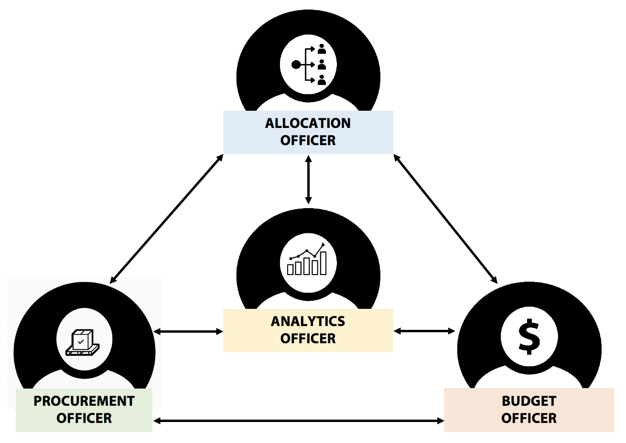
1.
Public Sector Roles
Setting the Scene

Slide 8
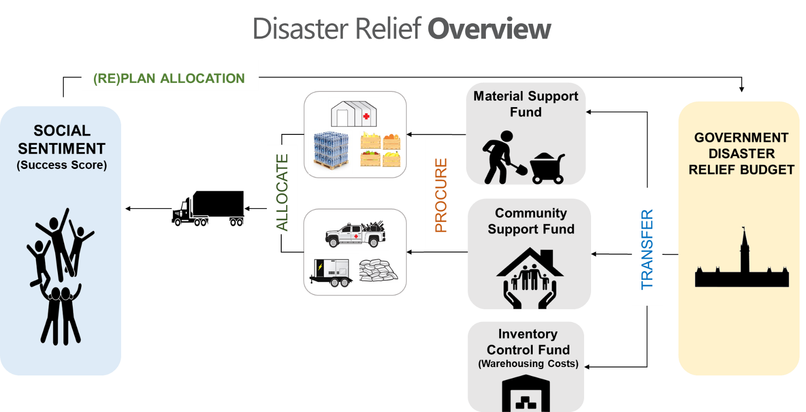
1.
ERPsim Manufacturing
Overview of Processes

Slide 9
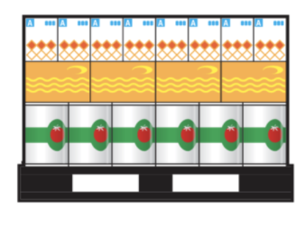
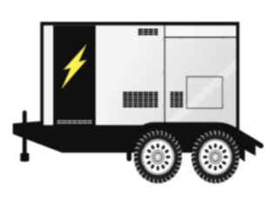
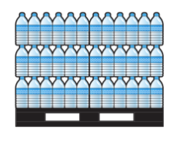
1.
Products & Services
What are we allocating?
Decontamination Services ($600/m³)
Food ($5000/pallet)
Emergency Power ($300/MWH)
Water ($2000/pallet)
Sandbags ($1000/pallet)
Portable Shelters ($200/m²)

Slide 10
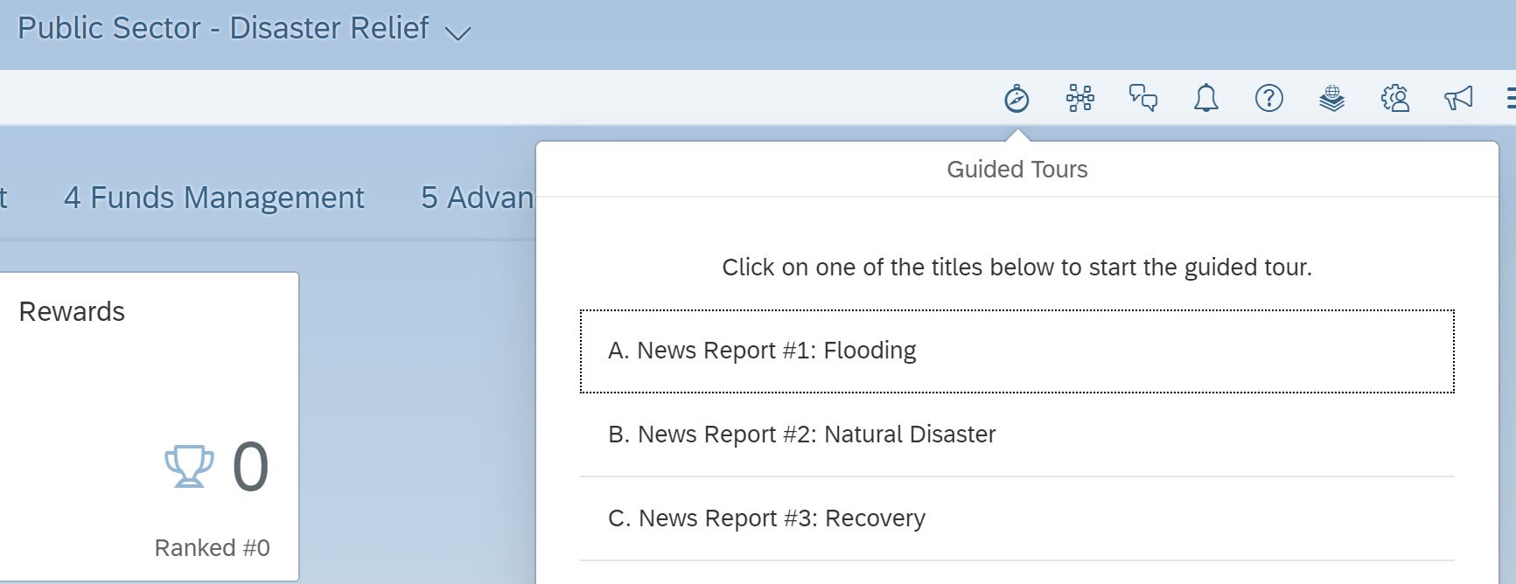
1.
Weather Reports
Setting the Scene

Slide 11
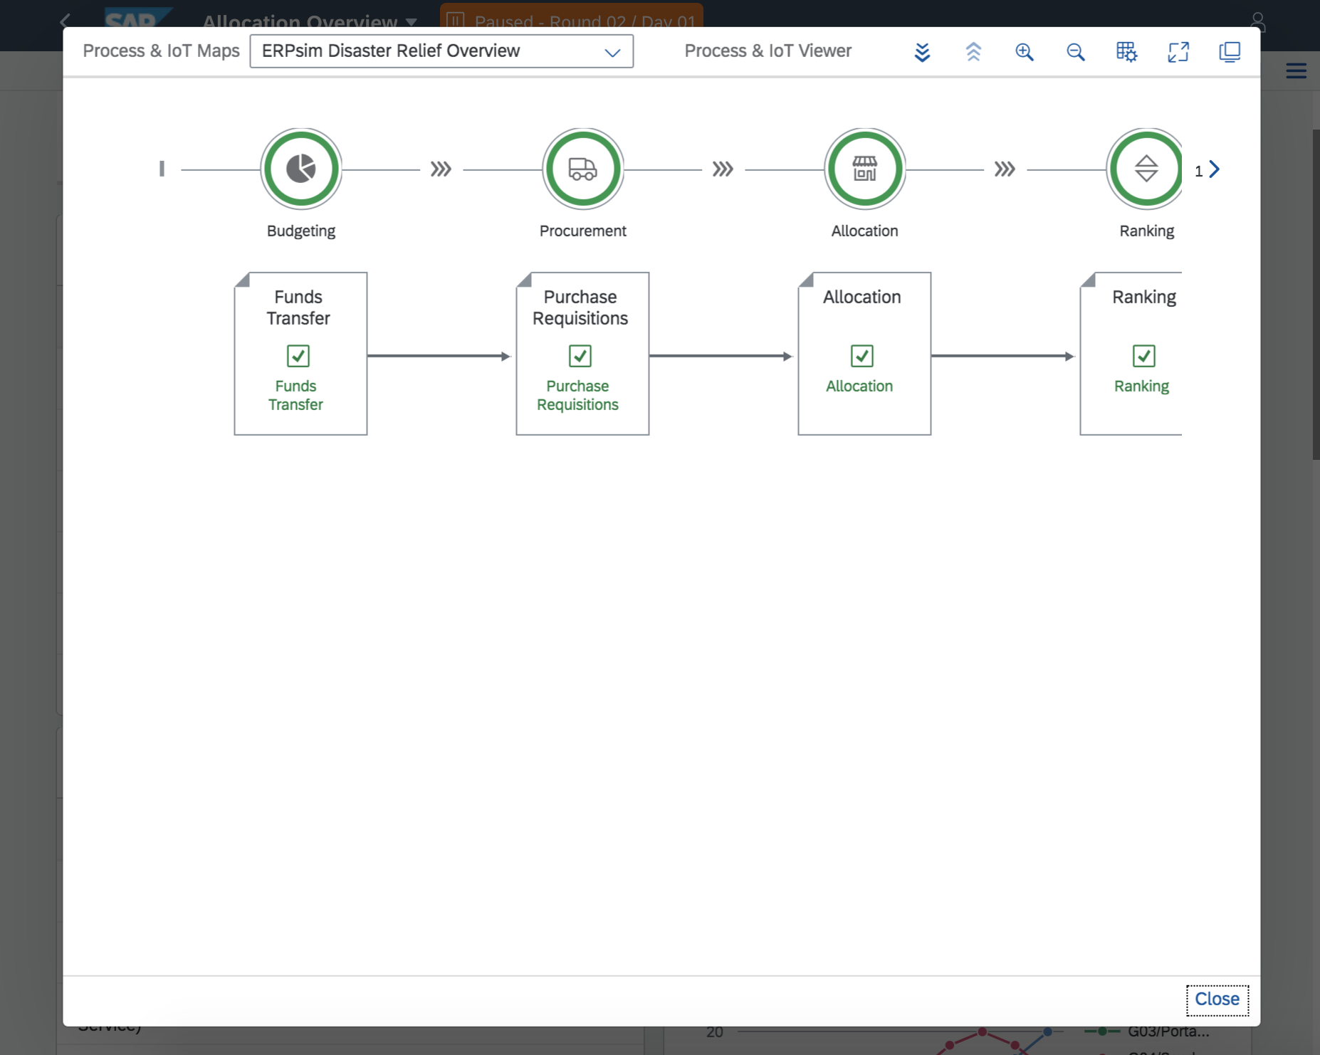
2.
Digital Acceleration Solution
Guiders and Help
Right-clicking any tile on the launchpad launches contextual help menu
Frequently Asked Questions: Common questions
Process & IoT Viewer: Dynamic overview of business processes
Notifications: System state alerts

Slide 12
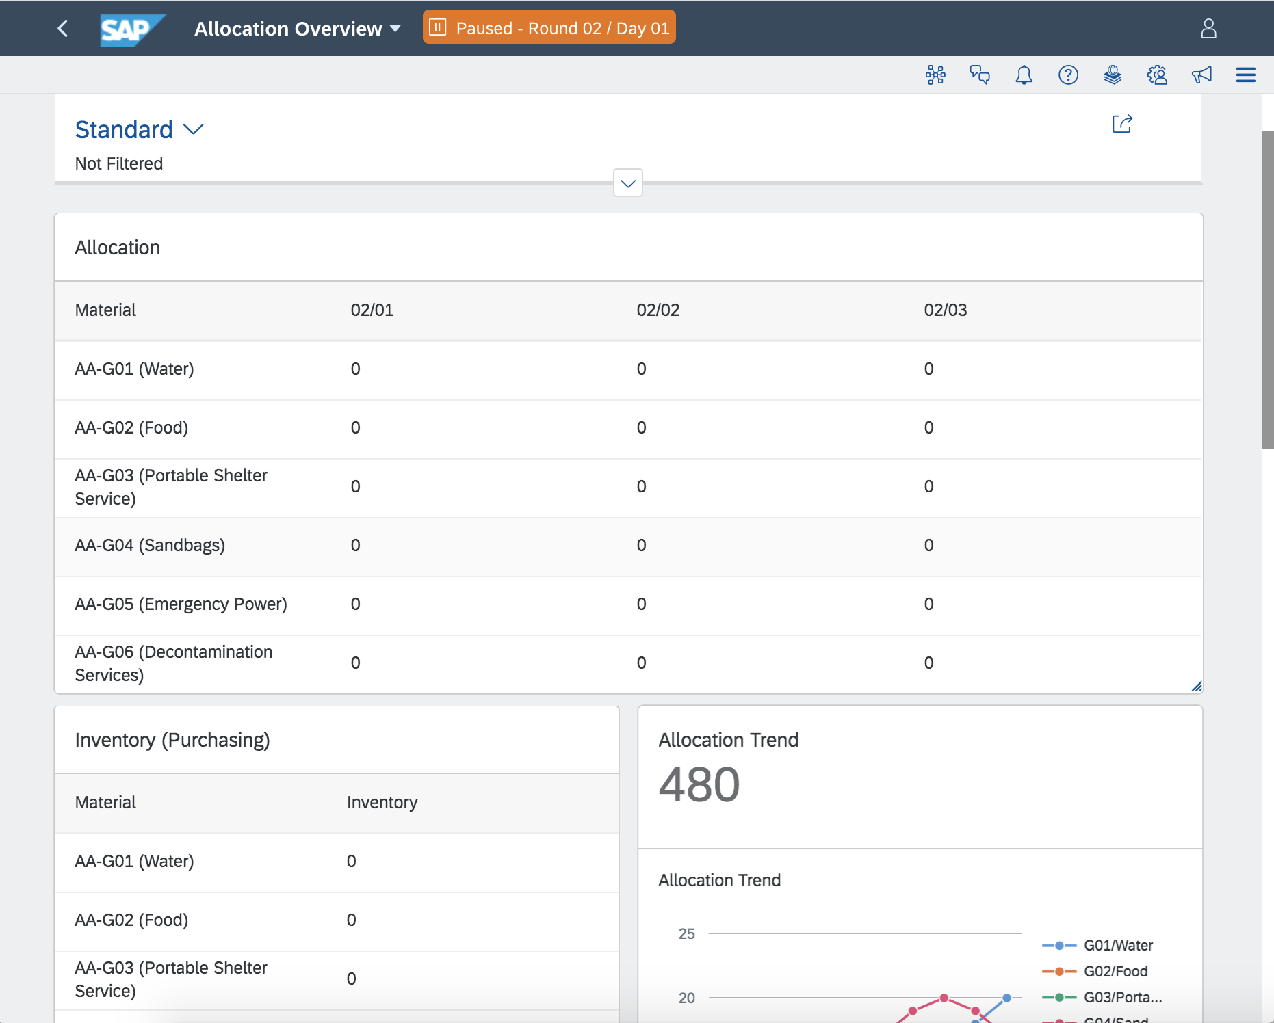
2.
Overview Tiles
1909
Dashboards which can be used to better organize the KPIs and metrics available for each role
In the PS scenario, dashboards can be used to make transactional changes
Each role for every scenario will have access to these dashboards
Public Sector scenario:
Allocation Overview
Procurement Overview
Funds Management Overview
Advanced Overview

Slide 13
3.
Fiori Overview
Public Sector Scenario
We will now move to the ERPsim Fiori Launchpad, where we will:
Review participant roles
Review differences between rounds and round-based gameplay
Demo key processes, transactions and analytics
Demo our Digital Acceleration Solution
Also consider
Starting a game using the Game Controller and playing as one of the teams
Reviewing the help in DAS
Change the allocation plan and invest and review the analytics and the reports in the game controller.
Complete the procurement process.
Take note of challenges and questions which arise, both as an instructor and participant

Slide 14
4.
Instructional Tips
Session Timeline
Round 0
Focus on Reviewing Major Processes: Budgeting, Procurement & Allocation
Before Round 0:
Review DAS Contents: Guided Tours & FAQ
Provide an overview of the simulation (storyline)
Introduce round 0 and any terminology
Show pre-configured allocation plan, inventory, budget
Show News Report #1
Round 0 gameplay (10 minues)
PAUSES:
DAY 5: Demo how to change allocation plan, perhaps demo other processes
After Round 0
Reset the simulation

Slide 15
4.
Instructional Tips
Session Timeline
Round 1
Round 2
Round 3
Focus on Allocation Planning & Procurement
Before Round 1:
System introduction (login, navigation, roles)
Review pre-set Allocation Plan, fund accounts and current inventory
Show News Report #1
Optional: Play Round 0
Round 1 gameplay
PAUSES:
DAY 3: Demo how to change allocation plan
DAY 5: Demo how to procure more inventory
Round 1 debrief
Focus on Budget Transfers
BEFORE ROUND 2
Show replenished disaster relief budget
Demo the budget transfer process
Show News Report #2
Round 2 gameplay
OPTIONAL PAUSE:
DAY 5: Check-in
Round 2 debrief
Focus on Strategizing
BEFORE ROUND 3
Show News Report #3
Round 3 gameplay
END OF GAME (20 minutes): Celebrate and review final Game Controller reports

Slide 16
4.
Expert Tips
ERPsim Public Sector
The overall objective is to spend your entire budget and deplete inventory for products and services which are high in demand.
There is no benefit to accumulating leftover budget or to hoarding products and services.
With that said, allocating products and services which are not in demand will lower social sentiment score.
For the embedded “News Reports”, the quality of translation might be questionable. Use the Youtube subtitle function to change the language of the closed captions or to turn them off. To do so, click the gear icon, select subtitles and then your desired language.

Slide 17
5.
Debriefing
Public Sector Scenario
How can you effectively debrief the Public Sector scenario:
Review participant roles
Review differences between rounds and round-based gameplay
Demo key processes, transactions and analytics
Demo our Digital Acceleration Solution
Also consider:
Using the game controller reports to your advantage
Changing the approach you use to deliver the scenario

Slide 18
Next steps
Module 6
Revise the material for this module
Review the material available on the instructor portal
Review Module 3: Game Controller
Complete the practice activities and familiarize
yourself with the Fiori Launchpad
Complete the Module 6 quiz

