Slide 1

BATON SIMULATIONS
ERPsim Online
Train-the-Trainer
Module 5: ERPsim Manufacturing

Slide 2

This module covers
Introduction to the Manufacturing Scenario
1909 Overview Tiles
Instructional Tips & Tricks
Roles & Gameplay
Debriefing Manufacturing

Slide 3

1.
ERPsim Manufacturing
Overview
Participants manage a make-to-stock manufacturing company that sells muesli breakfast cereals
Compete against the other wholesalers (teams) to satisfy customer demand and maximize profit!
Participants begin the process with the most fundamental elements: sales, marketing, tracking inventory, and observing sales.
In the second round, they are introduced to the production process by releasing existing planned orders (using the raw material already in stock).
Finally, they master planning and procurement, facilitating replenishment of raw materials.
Objective
help participants learn the fundamentals of SAP navigation and experience the dynamic operation of SAP in a full cash-to-cash process.
Requirements
Approximately 3 to 8 hours to conduct a session
Updated web browser and decent bandwidth
NO SAP KNOWLEDGE REQUIRED!

Slide 4
1.
Rules
Warehousing, Forecasting and Marketing
NO extra warehousing costs in the manufacturing scenario.
Introduction scenario, start with 100,000 boxes for each variety and enough raw materials to produce new finished goods to that level for each variety.
participants are not allowed to change the Bill of Material (BoM)
Marketing Tip: 2 to 3% of total revenue is more than enough

Slide 5
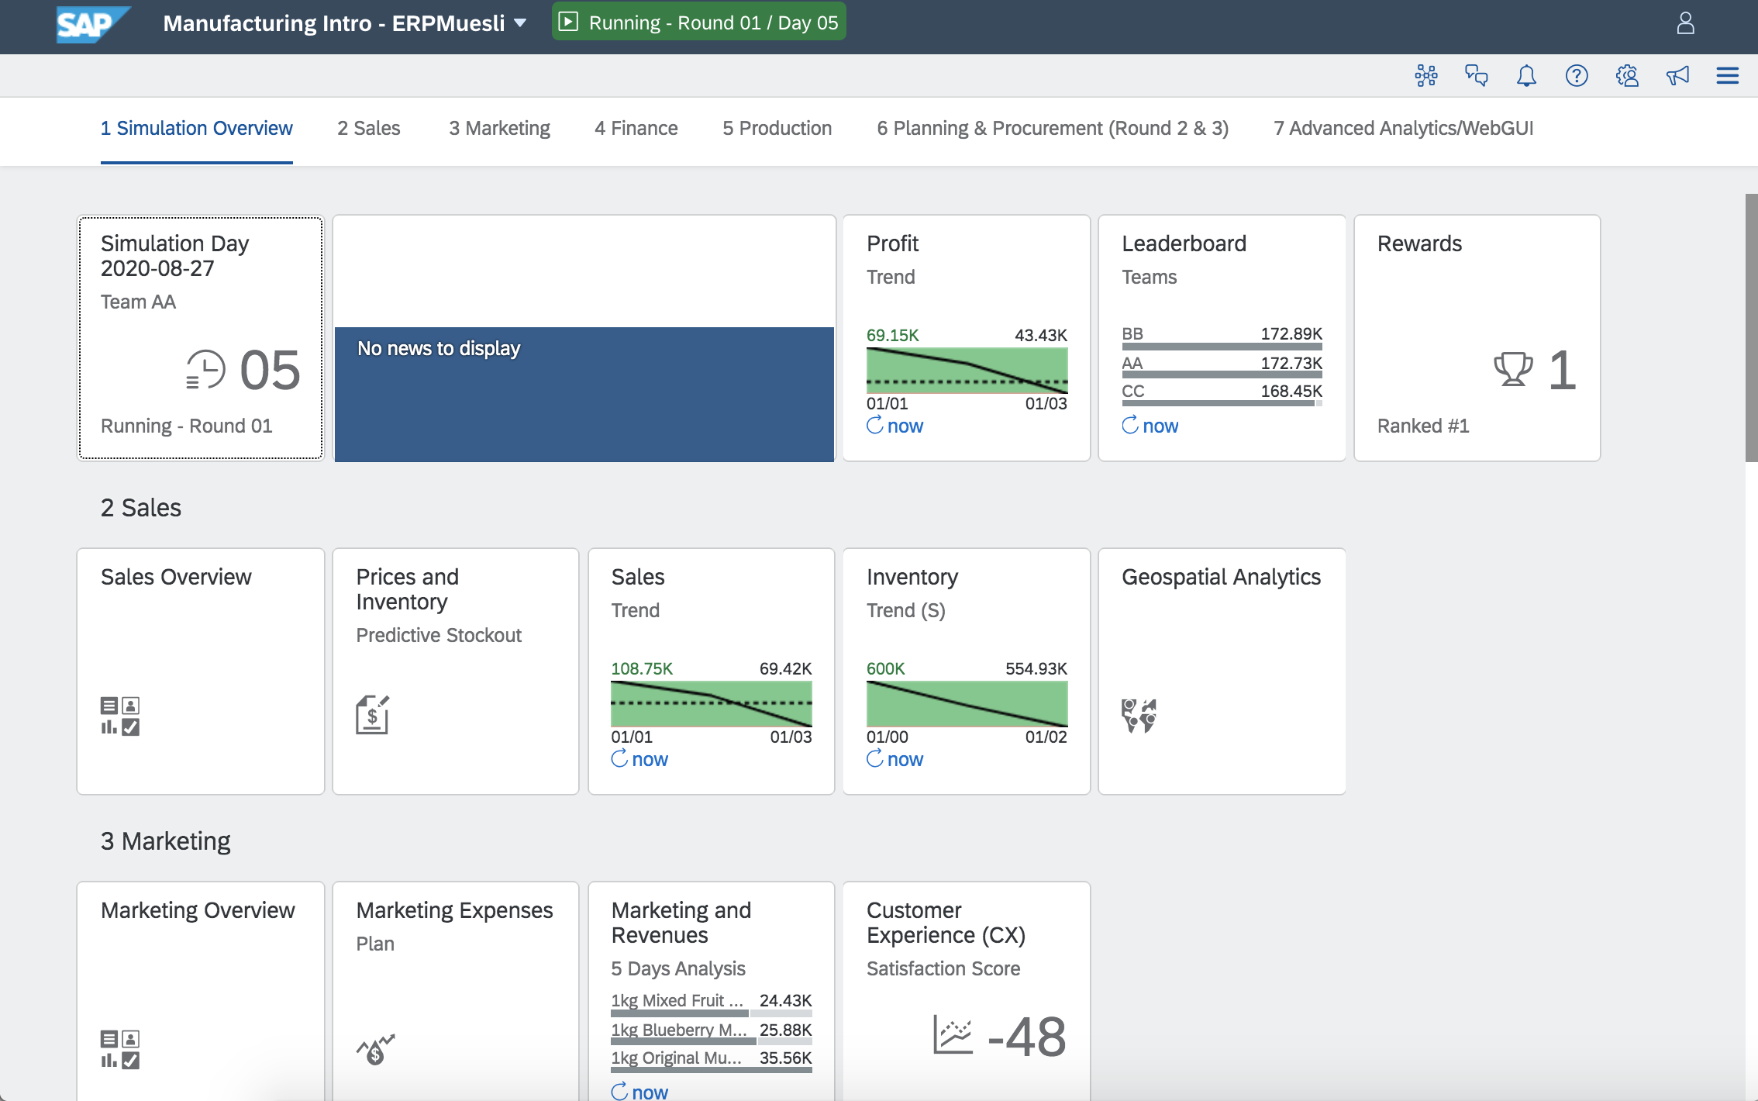
1.
Setup
Warehousing, Forecasting and Marketing
In the Introduction scenario, we recommend 3 rounds of thirty minutes.
As for set up, the manufacturing introduction scenario generally consists of:
1 minute/virtual day
30 days/round
3 rounds/game (up to 8 rounds/game)
3 regions
2 distribution channels
6 products to manufacture
Starting inventory: 100000 units/product
Production Capacity of 25000 units/day, at 100% capacity
Supplier Lead Time: 1-5 days
Supplier Payment Time: 10-30 days
Minimal time required (estimated): 3h30-4h

Slide 6
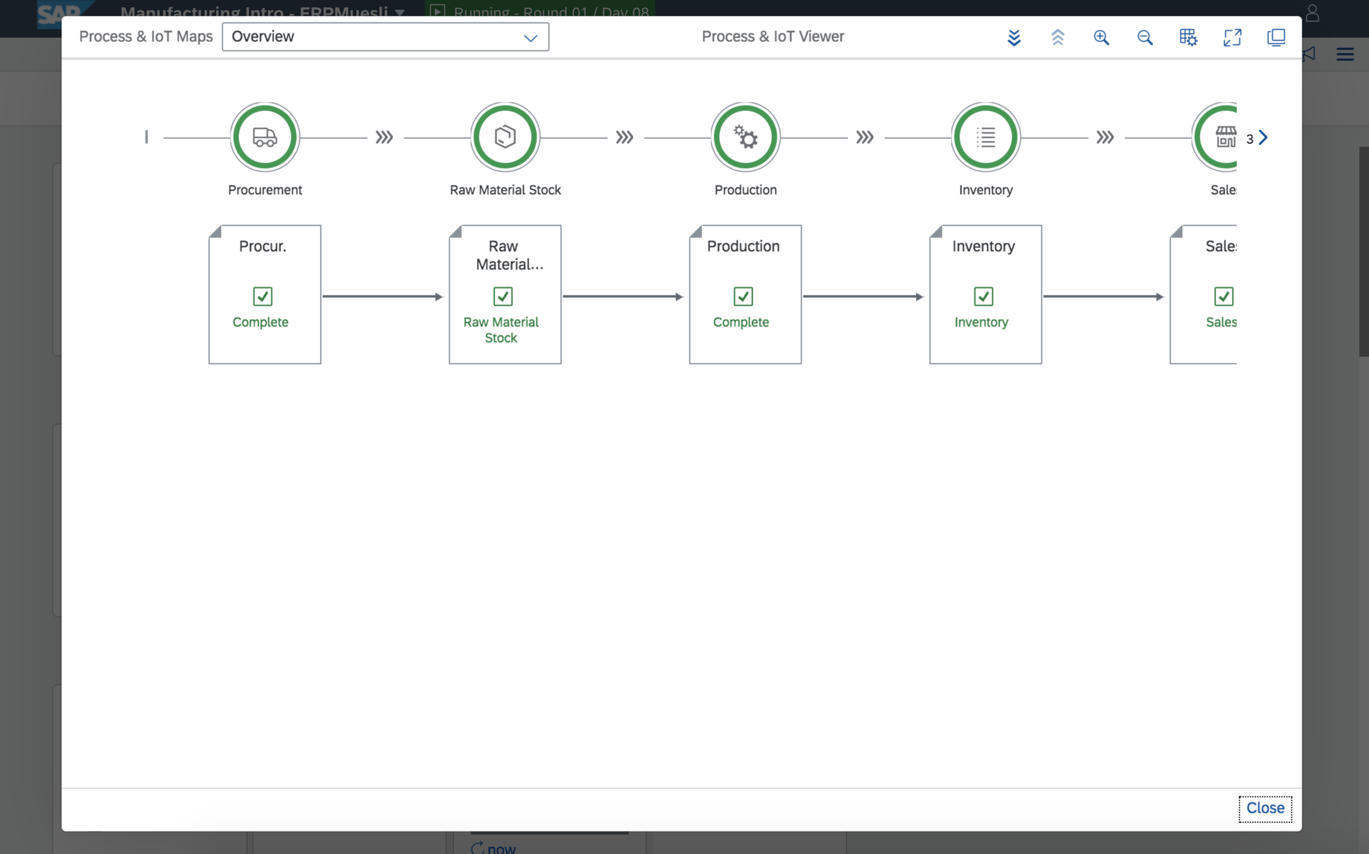
1.
Digital Acceleration Solution
Guiders and Help
Right-clicking any tile on the launchpad launches contextual help menu
Frequently Asked Questions: Common questions
Process & IoT Viewer: Dynamic overview of business processes
Notifications: System state alerts

Slide 7
1.
ERPsim Manufacturing Scenarios
Manufacturing Introduction
Manufacturing Introduction, companies start with 100,000 units of each of the 6 finished goods, (Nut, Original, Strawberry, Blueberry, Mixed and Raisins) as well as raw materials sufficient to produce an additional 100,000 units of each product.
In Round one, companies sell their initial stock by adjusting their selling price and marketing strategies.
In Round two, companies produce new finished goods from existing inventory of raw materials (converting existing planned orders to production orders).
In Round three, companies replenish their raw materials to the initial 100,000 units per product and as time permits, adjust their forecasts to above or below 100,000 units.

Slide 8
1.
ERPsim Manufacturing Scenarios
Manufacturing Short
Condensed version of Manufacturing Introduction. Companies start with:
96,000 units of 4 finished goods (Nut, Strawberry, Blueberry and Raisins)
Raw materials sufficient to produce an additional 96,000 units of each product.
We recommend:
3 rounds of twenty minutes.
This scenario is meant to be played in less time than the Manufacturing Introduction scenario.

Slide 9
1.
ERPsim Manufacturing Scenarios
Manufacturing Extended
Note: Playing Manufacturing Introduction is a pre-requisite for playing the Manufacturing Extended scenario.
Teams make all decisions and transactions from the start of the game.
Companies begin with no inventory of finished goods and raw materials.
They must plan their future sales through forecast, replenish raw materials, produce their finished goods, manage their prices, and invest in marketing.
They can also manage cash flow, change the BOM of finished goods, and invest in equipment and production efficiencies.
Sales and marketing begin only after the company has received raw materials and successfully started production.

Slide 10
1.
ERPsim Manufacturing Scenarios
Manufacturing Extended Continued
Companies begin with:
8 million Euros of debt
Production capacity of 21 000 units per simulated day
Setup time of 12 hours to switch between muesli varieties
Participants can invest to increase their production capacity, to reduce the setup time between the production of different products or repay their loan to lower bank interest.
While there is an unlimited line of credit, management of cash and dept will affect credit rating and interest rates. Teams can redesign their finished products by changing the bill of material making premium or budget varieties.
Can be played for up to 12 rounds of 20 minutes (4 rounds is typically long enough).

Slide 11
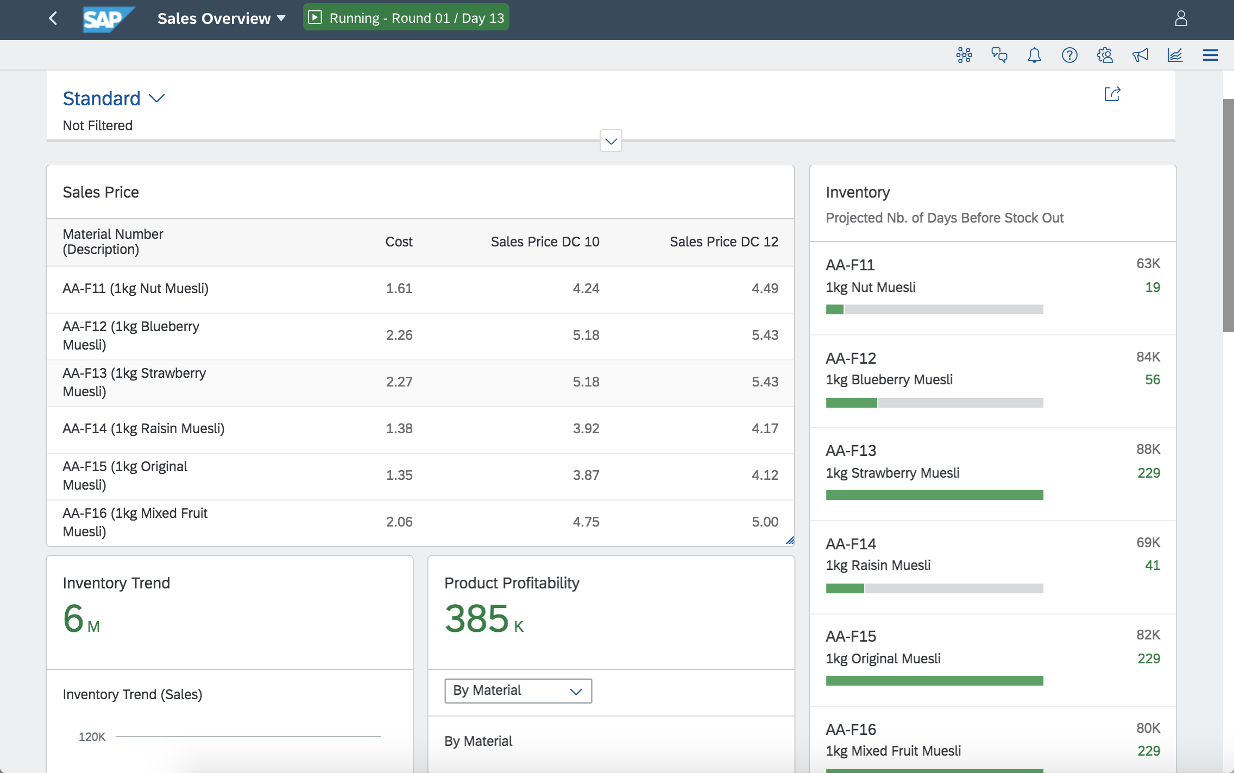
2.
Overview Tiles
1909
Dashboards which can be used to better organize the KPIs and metrics available for each role
Each role for every scenario will have access to these dashboards
Manufacturing scenario:
Sales Overview
Marketing Overview
Procurement Overview
Production Overview
Financials Overview

Slide 12
3.
Instructional Tips
Session Timeline
Round 1
Round 2
Round 3
Focus on Sales, Marketing and Finance
Before Round 1:
20 min overview and introduction
20 minutes system introduction (login, navigation, roles)
10 minutes explain pricing, marketing and financials
30 minutes Round 1 gameplay
20 minutes Round 1 debrief
Review leaderboard and reports
Focus on Production process
BEFORE ROUND 2
Provide production process example and in-Fiori navigation/steps.
30 minutes Round 2 gameplay
20 minutes Round 2 debrief
Review leaderboard and reports
Focus on Procurement of Raw materials
BEFORE ROUND 3
Introduce concept of procurements
Provide MRP example
Demo procurement process in Fiori
30 minutes Round 3 gameplay
END OF GAME (20 minutes): Celebrate and review final Game Controller reports

Slide 13
4.
Fiori Overview
Manufacturing Scenario
We will now move to the ERPsim Fiori Launchpad, where we will:
Review participant roles
Review differences between rounds and round-based gameplay
Demo key processes, transactions and analytics
Demo our Digital Acceleration Solution
Also consider
Starting a game using the Game Controller and playing as one of the teams
Reviewing the help in DAS
Change prices and invest in marketing to review the analytics and the reports in the game controller.
Complete the production and procurement process.
Take note of challenges and questions which arise, both as an instructor and participant

Slide 14
5.
Troubleshooting
Manufacturing Scenario
Common Questions
“MRP isn’t working correctly”Best way to highlight the learning experience embedded in ERPsim
“MRP generates no purchase requisitions”
“No planned production orders when starting round 2, or planned production orders which do not equal 100 000 per product.” “I keep running MRP, but nothing is ordered.”
“Can’t convert planned production orders.”
“MRP run is slow.”

Slide 15
5.
Debriefing
Manufacturing Scenario
What’s a good debriefing approach?
Reflect on what happened, participants may have been unaware when they were engaged with the simulation
Best way to highlight the learning experience embedded in ERPsim
Use a structured approach:
Transition: What did they experience?
Teamwork: What did your team do?
Connections: Can you see value for your customers or is there a connection to your everyday work life?
Debriefing suggestions:
Reserve at least 30 minutes for a structured debrief
Break before you debrief so they have some downtime
Reflect: Debrief your debrief
Come up with your own approach, make the debrief work for you!

Slide 16

Next steps
Module 5
Revise the material for this module
Review the material available on the instructor portal
Review Module 3: Game Controller
Complete the practice activities and familiarize
yourself with the Fiori Launchpad
Complete the Module 5 quiz

