Slide 1
BATON SIMULATIONS
ERPsim Online
Train-the-Trainer
Module 4: Facilitating ERPsim Distribution

Slide 2
This module covers
Distribution scenarios and storyline
Digital Acceleration Solution
Distribution Session Timeline
Fiori Overview
Debriefing
Next Steps

Slide 3
1.
Distribution Simulation
Storyline
Participants run a wholesale distributor of bottled water
Compete against the other wholesalers (teams) to satisfy customer demand and maximize profit!
Shortest and simplest simulation offered
Teams will be responsible for buying and selling 3 flavors of bottled water in 2 sizes
Teams start with 1000 units for each product or 6000 units in total.
Objective
Introduce participants to the basic concepts of SAP navigation
Requirements
Approximately 2 to 3 hours to conduct a session
Updated web browser and decent bandwidth
NO SAP KNOWLEDGE REQUIRED!

Slide 4
1.
Scenarios vs. Skins
Key differences
Two distinct scenarios available
Distribution Short (10 days/round; 45 minutes)
Distribution Standard (20 days/round; 3 hours)
Skins: Products and vendors which will be referred to on your bill of materials.
Water Bottles: Teams distribute water bottles
Snacks: Teams distribute healthy snacks
Customizing the bill of materials
Distribution short
Short time frame, best used as a demo experience
Distribution standard
Full ERPsim experience, covers SAP navigation, basic transactions and business process
Contact us:
info@batonsimuations.com

Slide 5
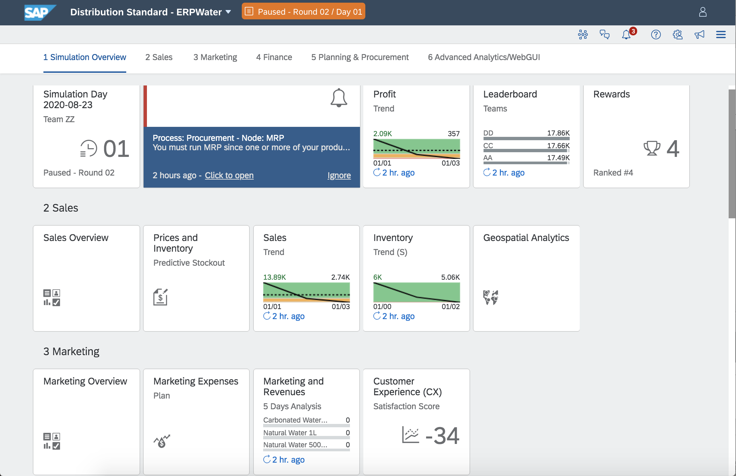
1.
Rules and Setup
Warehousing, Forecasting and Marketing
Warehousing costs: Incurred when teams keep > 6000 units in inventory
Forecasting: Beyond 6000 will decrease profit
Marketing Tip: 2 to 3% of total revenue is more than enough
Setup:
1 minute/virtual day
20 days/round
3 rounds/game
3 regions
1 distribution channel
6 products to distribute

Slide 6
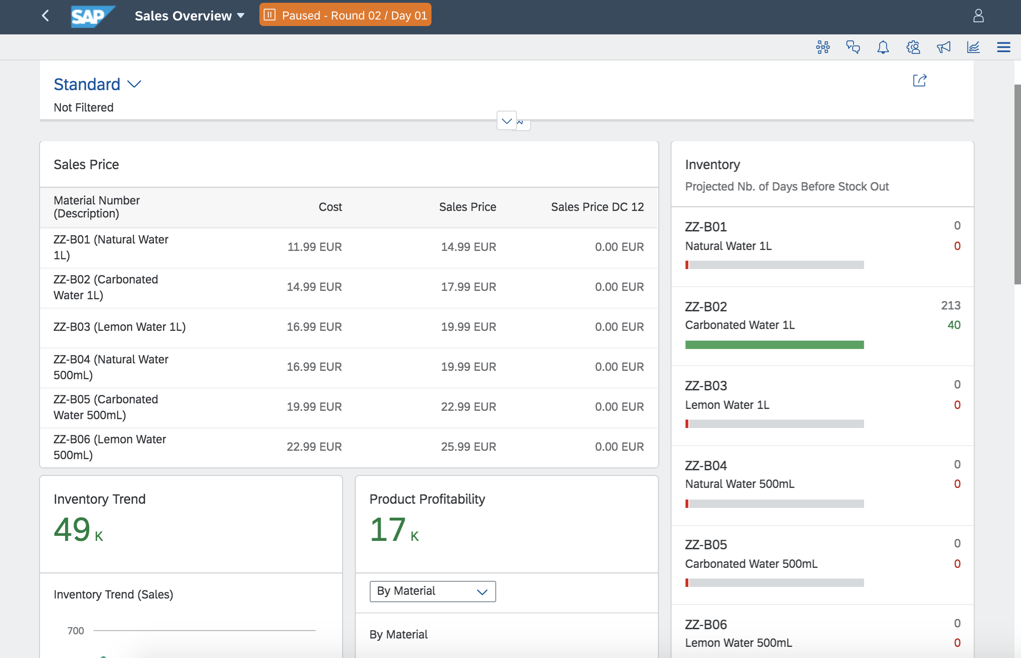
1.
Overview Tiles
1909
Dashboards which can be used to better organize the KPIs and metrics available for each role
Each role for every scenario will have access to these dashboards
Distribution scenario:
Sales Overview
Marketing Overview
Procurement Overview
Financials Overview

Slide 7
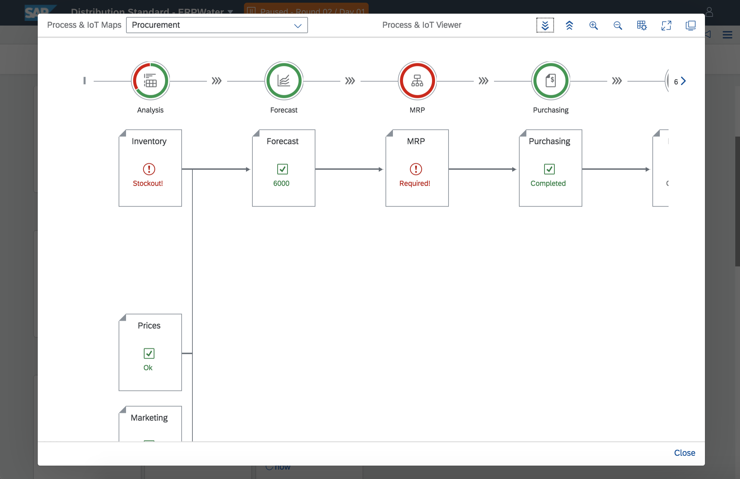
2.
Digital Acceleration Solution
Guiders and Help
Right-clicking any tile on the launchpad launches contextual help menu
Frequently Asked Questions: Common questions
Process & IoT Viewer: Dynamic overview of business processes
Notifications: System state alerts

Slide 8
3.
Session Timeline
When to pause and what to say
Round 1
Round 2
Round 3
Focus on Sales, Marketing and Finance
PAUSES
DAY 5: Show Profit Trend, Leaderboard, Sales trend, Sales Analysis, Inventory Trend, Marketing and Revenue, Cash Balance, Net, Profit/Lost, Price Market Report
BETWEEN DAYS 10 & 20: Show Geospatial analytics
END OF DAY 20: Game Controller reports
Focus on Replenishment process
BEFORE ROUND 2
Provide real-life MRP example and explain the concept of requirements
Demo how to change requirements and an MRP Run
Explain Manage Purchase Requisitions, POs
Demo DAS
PAUSES (OPTIONAL)
DAY 10: Explain Competitive Analytics
END OF DAY 20: Game Controller reports
Focus on Team Strategy
BEFORE ROUND 3 allow participants time to strategize
END OF GAME: Celebrate and review final Game Controller reports

Slide 9
4.
Fiori Overview
Distribution Scenario
We will now move to the ERPsim Fiori Launchpad, where we will:
Review participant roles
Review differences between rounds and round-based gameplay
Demo key processes, transactions and analytics
Demo our Digital Acceleration Solution
Also consider
Starting a game using the Game Controller and playing as one of the teams
Reviewing the help in DAS
Change prices and invest in marketing to review the analytics and the reports in the game controller
Take note of challenges and questions which arise, both as an instructor and participant

Slide 10
5.
Debriefing
Distribution Scenario
What’s a good debriefing approach?
Reflect on what happened, participants may have been unaware when they were engaged with the simulation
Best way to highlight the learning experience embedded in ERPsim
Use a structured approach:
Transition: What did they experience?
Teamwork: What did your team do?
Connections: Can you see value for your customers or is there a connection to your everyday work life?
Debriefing suggestions:
Reserve at least 30 minutes for a structured debrief
Break before you debrief so they have some downtime
Reflect: Debrief your debrief
Come up with your own approach, make the debrief work for you!

Slide 11
6.
Next steps
Module 4
Revise the material for this module
Review the material available on the instructor portal
Start a few games and practice in the Fiori Launchpad
Complete the learning exercises
Complete the Module 4 quiz

