Slide 1
BATON SIMULATIONS
ERPsim Online
Train-the-Trainer
Module 1: What is ERPsim?

Slide 2
This module covers
Introduction to the training
Introduction to ERPsim
Behind the scenes
Tips and tricks

Slide 3
1.
Introduction to the Training
Training objectives
Our intentions are to provide accessible, affordable and learner specific training and development materials for the certification of future ERPsim™ instructors.
Through live, scheduled interaction with ERPsim™ experts, self-administered assessments and self-paced virtual training, you will be exposed to the ERPsim™ environment as well as fundamental aspects of business processes and instruction.
By the end of this training you will be able to:
Request, administrate and facilitate ERPsim™ training sessions and events
Design and develop effective training sessions
Describe and model the business processes of ERPsim™

Slide 4
1.
Introduction to the Training
Training overview
Our Training consists of :
Self-paced guided instruction delivered through a series of annotated videos spread over 8 modules, facilitated by experts at Baton.
Access to an instructor-led webinar where we will review material, answer questions and discuss ERPsim updates
Access to a practice space (live SAP S/4HANA client and Fiori Launchpad)
A number of ‘checkpoints’ embedded within the overall course design. Quizzes/Assignments will be administered at the end of each module. A passing grade of 60% is required on the module assessments to be able to qualify for the final exam.

Slide 5
1.
Introduction to the Training
Training modules
To be certified as an ERPsim™ trainer, you are required to complete all eight modules and associated assessments of this training program:
Introduction to ERPsim
Exploring the SAP Fiori Launchpad
Exploring Baton’s Instructor Portal & Game Controller
Overview of ERPsim Distribution
Overview of ERPsim Manufacturing
Overview of ERPsim Public Sector
Debriefing ERPsim
How to Conduct Virtual ERPsim sessions (using Zoom)

Slide 6
2.
Introduction to ERPsim
Baton Simulations
Established in 2009 in Canada, Baton has deep roots in organizational change management (OCM) and learning innovations based on business software like SAP ERP.
As experts in OCM, we know software doesn’t solve business problems—people do.
Our raison d’être is to help these leaders realize their visions for digital transformation with powerful solutions that enable rapid change at each stage of the journey.
Our solutions ERPsim™, DAS, and DAS Language Localizer, help leaders manage the people side of the equation while leveraging the technology side through faster adoption and better collaboration and communication across global organizations.
Based in Montréal, Canada, we serve customers in more than 40 countries, on every continent, directly and through our elite channel partner network of systems integrators, training consultancies, and software vendors.

Slide 7
2.
Introduction to ERPsim
ERPsim
Created in 2004 to teach ERP systems to undergraduate and MBA student, ERPsim is a business simulation that runs on a live SAP ERP system.
Since 2009, Baton as started commercializing ERPsim to companies who are looking to implement SAP, to train their employees or to create a team building event.
The academic version is now used in more than 250 universities around the world.
In ERPsim, a fast-paced simulated environment, participants must optimize decisions by sharing information and collaborating using ERP.
Participants, in small teams, gain more than just an appreciation of enterprise software—they also witness the impact on company performance of communicating and collaborating up- and downstream in an end-to-end process.

Slide 8
2.
Introduction to ERPsim
ERPsim
Created in 2004 to teach ERP systems to undergraduate and MBA student, ERPsim is a business simulation that runs on a live SAP ERP system.
Since 2009, Baton as started commercializing ERPsim to companies who are looking to implement SAP, to train their employees or to create a team building event.
The academic version is now used in more than 250 universities around the world.
In ERPsim, a fast-paced simulated environment, participants must optimize decisions by sharing information and collaborating using ERP.
Participants, in small teams, gain more than just an appreciation of enterprise software—they also witness the impact on company performance of communicating and collaborating up- and downstream in an end-to-end process.

Slide 9
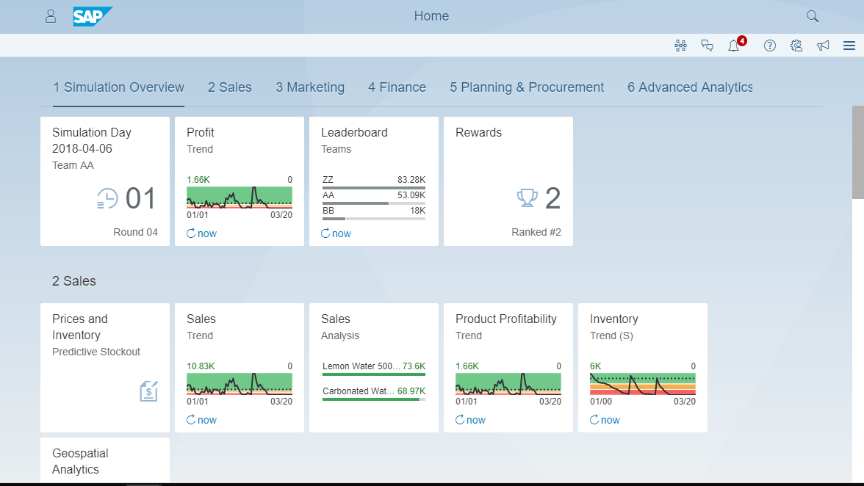
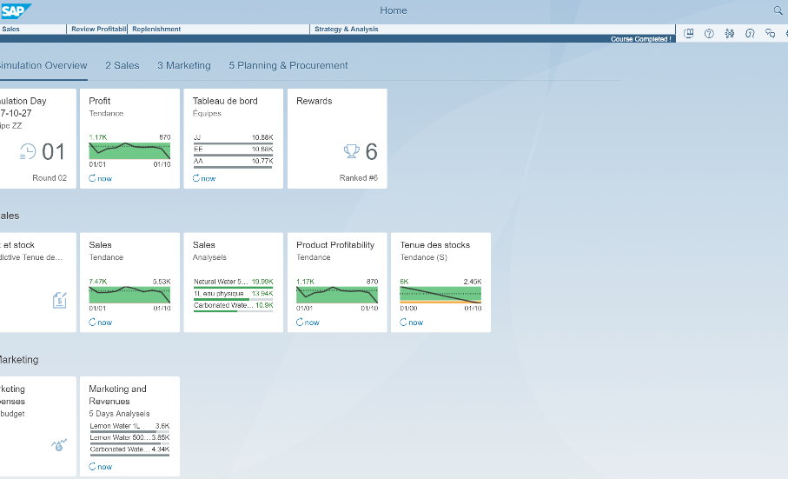
2.
Introduction to ERPsim
What is ERPsim?
Real SAP S/4HANA
Engaging Experience
ERPsim is a business simulation that runs on a live SAP S/4HANA system.
Live competition that promotes an engaging, fun experience for all levels of employees from executives to new hires.
End-to-End Process
Run Your Own Business
Each team runs their own company, making key business decisions while executing multiple business transactions such as planning, sales, marketing, procurement and finance.
Participants experience end-to-end process integration and the value of real-time analytics in a competitive business setting.

Slide 10
2.
Introduction to ERPsim
What is ERPsim?
SIMULATION ENGINE |  |  | PARTICIPANTS
1 | Customer and supplier behavior algorithms |  | 1 | Business decisions
2 | Simplification of administrative tasks |  | 2 | Business analytics
3 | Time acceleration |  | 3 | End-to-end process collaboration
SAP Cloud Platform

Slide 11
2.
Introduction to ERPsim
How does it work?
What makes ERPsim possible?
Simply put, the ERPsim architecture is composed of a simulation controller integrated with a real SAP S/4 HANA on-premise system.
Built with Java, the simulation engine automatizes business transactions in SAP using standard BAPIs.
As an added feature, embedded within the presentation layer of the standard Fiori Launchpad, Baton’s Digital Acceleration Solution (DAS), which is hosted on the SAP Cloud Platform, enhances end-user experience in Fiori, providing step-by-step guidance and process overviews.
As an instructor, you will have access to the Baton Portal, hosted on the SAP Cloud Platform, which provides you with a single workspace. Here you will find all the requisite training materials and the ability to plan, deliver and control your sessions.
Details about DAS l are presented in future modules.

Slide 12
2.
Introduction to ERPsim
How is ERPsim used?
ERPsim is used to promote experiential learning within your organization and engage your colleagues and employees through:
Real-world problems: Participants solve real-world business problems in a safe environment that encourages them to experiment and learn from their successes and mistakes, individually and as a team.
Guided realization: Each simulation concludes with a debrief in which participants reflect on their decision-making thinking and behavior and the impact on outcomes, with the help of the instructor.
Interaction with a live SAP S/4HANA with Fiori interface: All our simulations are run on live SAP S/4HANA, with the Fiori interface showcasing powerful real-time analytics to support participants decisions.

Slide 13
2.
Introduction to ERPsim
Available scenarios
Introduction to real-life S/4HANA
Impactful with executives in retail/distribution across industries
Duration : 1.5h - 3h
A realistic manufacturing scenario
Popular with manufacturing companies and for full day trainings.
Duration : 3h-1day
Showcasing the latest S/4HANA for Public Sector
Applicable to all public sector and defence organizations
Duration : 3h-1day
ERPsim is available in several different scenarios, with varying outcomes. Choose the simulations to suit your business application.
Manage the purchase and sale of bottled water products, using real-time reports to track business performance in an unpredictable, competitive market.
Participants manage the cash-cash cycle of a small manufacturing company, including planning, procurement, manufacturing, sales, marketing and finance.
Experience funds & budget management, procurement, spend and monitoring of your program effectiveness in a generic PS process.
Distribution
Manufacturing
Public Sector

Slide 14
2.
Introduction to ERPsim
The distribution scenario
Introduction to real-life S/4HANA
Impactful with executives in retail/distribution across industries
Duration : 1.5h - 3h
The distribution simulation is for teams engaged in the purchase and sale of products.
Also known as ERPWater, it acts as a dynamic introduction to ERP and can be completed in under 3 hours.
Using a select set of transactions and reports, participants manage purchasing and sales of bottled water products in a volatile market.
This simulation is impactful with executives and end users in retail and distribution.
Also within our distribution repertoire is our ERPsim™ Snacks skin. This latest addition to the ERPsim lineup, ERPsim Snacks empowers users with rich analytics in the Fiori interface as they distribute healthy snacks.
Manage the purchase and sale of bottled water products, using real-time reports to track business performance in an unpredictable, competitive market.
Distribution

Slide 15
2.
Introduction to ERPsim
The manufacturing scenario
Introduction to real-life S/4HANA
Impactful with executives in retail/distribution across industries
Duration : 1.5h - 3h
The manufacturing simulation is for teams integrating planning, procurement, manufacturing, marketing, sales, and finance.
Also known as ERPMuesli, participants manage the cash-to-cash cycle of a manufacturing company, including planning, procurement, manufacturing, sales, marketing, and finance.
To achieve optimal results in this fast-paced scenario, teams must collaborate using analytics to capture market share. Available as a half-day or full-day session.
There are 3 versions of the manufacturing scenario, short, intro and extended, each of them coming with a different level of difficulty and duration.
A realistic manufacturing scenario
Popular with manufacturing companies and for full day trainings.
Duration : 3h-1day
Manage the purchase and sale of bottled water products, using real-time reports to track business performance in an unpredictable, competitive market.
Participants manage the cash-cash cycle of a small manufacturing company, including planning, procurement, manufacturing, sales, marketing and finance.
Distribution
Manufacturing

Slide 16
2.
Introduction to ERPsim
The public sector scenario
Introduction to real-life S/4HANA
Impactful with executives in retail/distribution across industries
Duration : 1.5h - 3h
Showcasing the latest S/4HANA for Public Sector
Applicable to all public sector and defence organizations
Duration : 3h-1day
The Public Sector scenario is for teams managing public funds to address meaningful challenges and improve the lives of citizens.
Also known as Disaster Relief, participants can experience funds and budget management, procurement, spending and monitoring of program effectiveness in a generic public sector process.
Applicable to public sector organizations, universities, hospitals, and defense organizations as a half-day or full-day session
A realistic manufacturing scenario
Popular with manufacturing companies and for full day trainings.
Duration : 3h-1day
Manage the purchase and sale of bottled water products, using real-time reports to track business performance in an unpredictable, competitive market.
Participants manage the cash-cash cycle of a small manufacturing company, including planning, procurement, manufacturing, sales, marketing and finance.
Experience funds & budget management, procurement, spend and monitoring of your program effectiveness in a generic PS process.
Public Sector
Distribution
Manufacturing

Slide 17
2.
Introduction to ERPsim
Uses of ERPsim
Participants can see for themselves the value of ERP and end-to-end-process integration.
Participants collaborate to solve real-world business problems, learning to use the system in a realistic business environment.
ERPsim provides the ”Aha!” moments that make people support digital transformation and embrace enterprise software, especially in SAP S/4HANA implementation or upgrade.
It keeps your initiative moving forward by having multiple teams participate as needed.
It can revitalize support for digital transformation by running ERPsim to help people understand why it matters.

Slide 18
2.
Introduction to ERPsim
Target audiences
Who | When | Why
Executives | Whenever knowledge gap exists in understanding the role & benefits of SAP | Gain a deep appreciation of the value and integrated nature of SAP for their organization Understand SAP from the end user perspective Build a sponsor coalition
Project Teams | New project rollout New phase of implementation Migrations | Understand the benefits of integration Develop teamwork and improve motivation Understand the functions of ERP before go-live
End Users | Pre-Implementation Post-implementation, when inefficiencies are discovered | Understand of the power of SAP and increase user acceptance Unleash the power of individuals to discover inefficiencies in the business cycle
New Employees | During on-boarding process Refresher training workshops | Develop a deep understanding of the enterprise system from the get-go Instill commitment and loyalty to the organization
IT Professionals | Anytime | Broaden their functional understanding Engage with users from a business perspective Use ERPsim as a dynamic sandbox

Slide 19
2.
Introduction to ERPsim
Common objections
Misalignment of the scenarios with the organizations actual practices : It is important to keep the bigger picture in mind. Though not all organizations distribute water bottles, most people are able to understand the processes presented quite easily, and they can still benefit from hands-on interaction with S/4HANHA.
The simulations are over-simplified: The goal of doing ERPsim is not to try to replicate an exact enterprise process. After all, the simulation is run in only a few hours and each of the virtual companies are managed by a very small number of players.
It’s not the real SAP: Yes, yes it is! It’s a live SAP S/4HANA system with a real Fiori Launchpad. We are using a custom simulation engine to run real transactions in SAP and simulate the time passing.

Slide 20
3.
Tips & tricks
In person session requirements
ERPsim is designed as a team event, we want to encourage communication and engagement. It works best when :
You have a good room layout that will facilitate good communication within each team, while providing some level of “private” team conversations.
Arranging the room “café style”, using small squares or round tables which participants adequate space, and maximum opportunity for conversation.
For traditional classroom style arrangements, try to arrange the space to maximize team conversations and provide some space between teams.
Plan for a big screen or a projector to show the participants your screen.
Use a white board or a flip chart to write additional information or instructions.

Slide 21
3.
Tips & tricks
Wifi
ERPsim events require good internet access and adequate bandwidth for participants and facilitator.
Network bandwidth requirements for the duration of the game is similar to that of heavy web browsing or high-quality video streaming
We recommend at least 40 Mbps of bandwidth for every 30 attendees.
We recommend that you test the venue’s Wifi ahead of time
Participants should make sure to have as few as possible windows open on their computer at all time.
Limit the number of browsers and browser windows

Slide 22
3.
Tips & tricks
Devices
Though our simulations are web-based, devices which do not have adequate processing power and memory may have performance problems (e.g. long load times).
We recommend the following :
Processor: 2.3 GHz minimum, 2.5 GHz recommended.
Memory: 6 GB RAM minimum, 8 GM RAM recommended.
All participants need to have access to a computer and its power supply.
For simulations onsite, iPads are also acceptable, but not necessarily recommended since it is harder to navigate.
Each device must have access to the latest version Internet Explorer, Safari, or Chrome. Please refer to our Fiori Web Browser Cheat Sheet, for more details on compatibility.

Slide 23
3.
Tips & tricks
Participants
Here are some tips regarding your participants :
Participants should understand in advance that they are expected to participate for the entire session.
“Stopping by for a half hour” is of little value and may be disruptive to the other attendees.
ERPsim is not designed as a spectator event.
Some participants, particularly in corporate settings, assume that they will be using their own SAP system or that the subject of the simulation will be industry specific. It is important to set expectations accurately.
Most participants appreciate knowing in advance the objective of the event as defined by the project owner or stakeholder.

Slide 24
3.
Tips & tricks
Virtual sessions
Using common web-conferencing software, real-time virtual delivery allows your organization to conduct scheduled ERPsim sessions, bringing instructors and participants online at a pre-determined time.
We find a virtual, live, interactive environment is better at replicating our engaging and competitive in-person delivery.
Module 8 will be entirely based on how to deliver successful virtual sessions

Slide 25
3.
Tips & tricks
The Instructor Portal
The instructor portal is where you can find all the resources for your sessions.
Take the time to review the materials found there, specifically:
The Instructor guide: your go to manual for everything and anything about delivering ERPsim.
The site prep guide. A detailed explanation of how to go about preparing for live, in-person classroom sessions.
The instructor presentation material. Instructional slides which will certainly help you deliver ERPsim. Everything you need for your first few sessions.

Slide 26
4.
Next steps
Module 1
Revise the material of this module
Review the material available on the instructor portal
Complete the Module 1 quiz

