Slide 1
BATON SIMULATIONS
ERPsim Online
Train-the-Trainer
Module 8:

Slide 2
This module covers
General Information on the ERPsim Launchpad
How to use Zoom
How to Manage Meetings, Participants & Coaches
Tips and tricks

Slide 3
1.
How to Prepare for Virtual Sessions
Selecting a scenario
Every ERPsim scenario can be delivered online
The scenario can be chosen based on:
The audience
The time available
Your own experience delivering ERPsim
It is important to allow sufficient time to complete the scenario!

Slide 4
1.
How to Prepare for Virtual Sessions
Technologies required
The organizers will need an online conference licence, like Zoom
Everyone taking part in the session will need a computer with an up-to-date browser
Everyone taking part in the session will need a microphone and a webcam
Unlike the onsite version of ERPsim, participants can’t use a tablet for the virtual sessions
Recommended browsers:
Google Chrome
Microsoft Edge
Safari
Recommended online conferencing:
Zoom

Slide 5
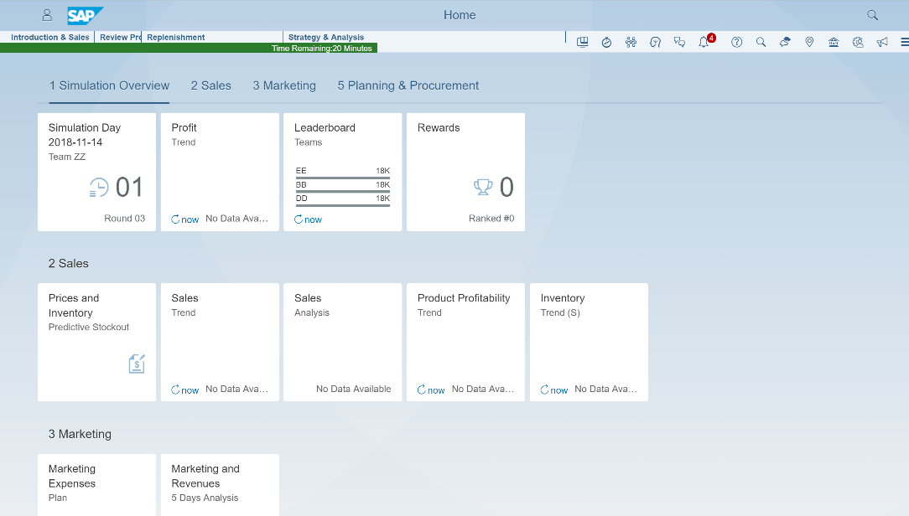
1.
How to Prepare for Virtual Sessions
Simulation Resources
DAS will help you deliver the simulation and will help your participants navigate Fiori
There are 4 main types of help:
FAQ
Right-click assistance (step-by-step)
Notifications
Process flow overview

Slide 6
1.
How to Prepare for Virtual Sessions
Timeline planning
2 weeks
4 days
1
day
Session day
Confirm the details with the customer
Request the system
Send meeting invite
You will receive system access
Start practicing with the system and Zoom
Prepare with your team
Have a last dry run with your team
Review the material, the objectives, etc
Log in to the Game Controller a few hours in advance
Pre-configure the game and see where the auto-login links are located

Slide 7
1.
How to Prepare for Virtual Sessions
Preparations for Instructors, Producers, Break Out Coaches
Instructor:
Delivering the content, running the game controller
Host (Producers):
Manage the Zoom meeting, ensure the management of the break out rooms
Break out room coaches:
Help the teams inside the breakout rooms, answer simple questions

Slide 8
1.
How to Prepare for Virtual Sessions
Create an agenda
Create a timeline detailing the required time for
Participants to join the meeting and get settled
Reviewing the introduction material
Reviewing Fiori instructions and Zoom
Creating the breakout rooms and getting everyone logged in Fiori
Allowing a few minutes for the teams to strategize
Also consider
How much time you plan on pausing the simulation during the rounds
Time required for debrief
Time required to introduce new concepts
Virtual sessions can take more time than onsite sessions given the technological challenges

Slide 9
2.
Zoom Setup
Instructional team
The instructor
The host
The coache(s)
Deliver ERPsim context and instructional content
Manage the simulation using the game controller
Configure simulation
Start and pause
Lead meaningful debriefs per round and at the end of the session
Manage participants
Mute microphones
Assigning breakout rooms
Troubleshoot Zoom
Help participants when they are in their breakout rooms
We recommend sending coaches into rooms only when needed

Slide 10
2.
Zoom Setup
The breakout rooms
Recommended rules when in breakout rooms:
Everyone should turn on webcams and microphones
Participants need to select a role
It is not advised that the participants work from a single shared screen, everyone should be completing actions on their own launchpad
Participants should use the “ask for help” button if they need to speak to an instructor

Slide 11
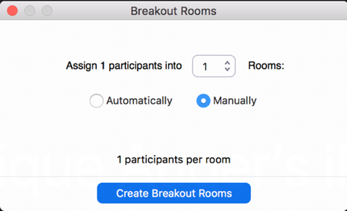
2.
Zoom Setup
How to use the breakout rooms
How to use and manage breakout rooms:
Only the Zoom host will be able to manage the breakout rooms
As a Zoom host, click on the Breakout Rooms button on the toolbar, you will see the following pop up box
Enter the number of rooms required and choose “Manually” if you would like to assign specific participants to specific rooms
If you have many instructors and coaches, you may want to create an additional breakout room for them
If not, choose “Automatically” to randomly assign participants to rooms (best for large groups or sessions without pre-determined teams)

Slide 12
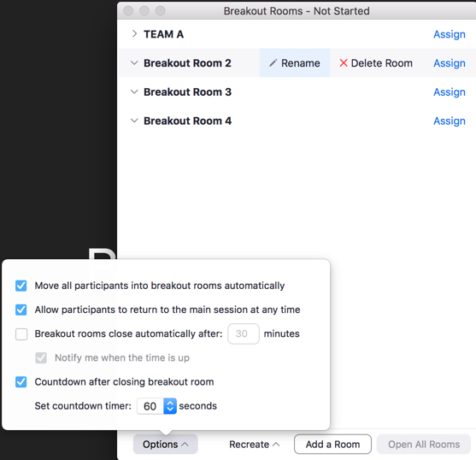
2.
Zoom Setup
How to use the breakout rooms
After selecting Create Breakout Rooms, you will see the following configuration window, within which you should:
Change the Breakout Room names to the assigned ERPsim Teams (TEAM A, TEAM B, TEAM C, …)
Assign 4 participants per team using the Assign button
Ensure that the first, second and third checkboxes under options are checked (as in the image)
And enter 10 seconds for your countdown timer
10

Slide 13
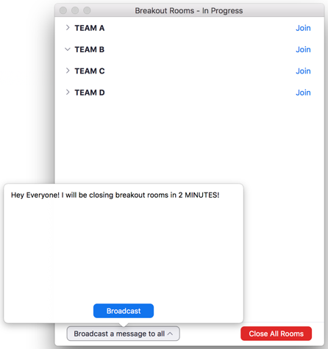
2.
Zoom Setup
Open the breakout rooms
Click Open All Rooms to activate your breakout rooms
When breakout rooms are active, use the broadcast function to send messages to the breakout rooms
Click Close All Rooms to bring back all the participants to the main room
Participants will be asked to join the main room or forced back to the main room after 10 seconds
To re-open breakout rooms from the main room, simply select the breakout room button on the toolbar and choose Open All Rooms

Slide 14
3.
Managing the session
Preparing the coaches
At least one day before your session, consider having a dry run with the instructional team to review the agenda for your session, main session objectives and their respective roles (producer, instructor, breakout room coaches)
Coaches are those who will help teams when they are in their breakout rooms:
If participants have questions and click the Ask for Help button, the producer can send a facilitator to assist
In large or mixed customers sessions, to help teams communicate
The coaches should have some basic knowledge of ERPsim, so they can answer the most common questions
Having a dry run with coaches and having them play as participants could be a good way to help them prepare (for you as well!)

Slide 15
3.
Managing the session
Preparing the participants
When scheduling and planning your session, keep your audience in mind, the participants:
In the meeting invitation for the session, consider adding additional details:
Technical requirements
How to join (desktop version of Zoom)
Computer audio and video
Instructions regarding how to access the simulation
Bandwidth and up-to-date browsers
Recommended browsers (Google Chrome, Safari and Edge)
Zoom meeting links, IDs and passwords. We strongly recommend:
Using passwords to protect against security breaches
Disabling the “join by phone” options as they will complicate the breakout room assignments
Resources to help them during the simulation, such as the simulation jobaid, which they can print and have on hand while they play
Contact information if they have any questions

Slide 16
3.
Tips & tricks
Zoom tips
A few tips and tricks to help you manage your session:
Don’t use a waiting room
MUTE all participants manually (if they are not already muted)
Zoom name! Ask participants to ensure their real name is displayed (& not a random string of numbers…)
If there are multiple presenters, hosts can ‘give control’ of their screen to another host or participant
Use the system messaging feature in the game controller to broadcast messages while ERPsim is running
Create a specific breakout room for your coaches. It makes it easier to bring them back to the main room when need be
If you do not see specific options in Zoom go to zoom.us and adjust your profile settings

Slide 17
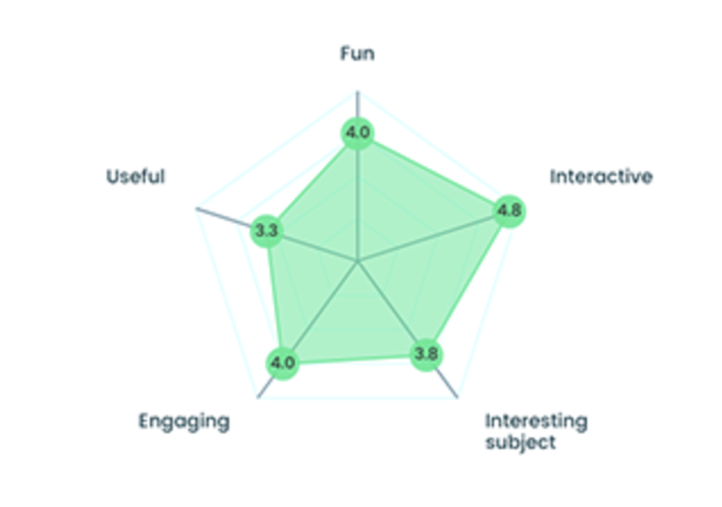
3.
Tips & tricks
General tips
A few more tips and tricks that could improve your experience delivering sessions:
Create an interactive survey at the end, it helps to collect feedback and debrief (look into survey tools like Qualtrics or Mentimeter)
Create quick and easy questions, one-word answers are fun!
Display feedback to participants
Review it as a group, it can help start a conversation

Slide 18
3.
Tips & tricks
Technical considerations
Minimal requirements
Extra care should be given to network capabilities and bandwidth, the web-conferencing system and testing access to SAP
Participants access to quality networks. Participants should make sure to have as few devices connected to their network, at all times during the event
Disconnect other devices
Prevent software updates (don’t update Windows at the same time!)
Avoid consuming other online content while
Limit the number of browsers and browser windows
When using the auto-login links, participants who have never played ERPsim before are not required to use incognito or in-private mode

Slide 19
4.
Next steps
Module 8
Revise the material for the scenarios you want to deliver
Try practicing the delivery of a virtual session on a few “low risk” colleagues or acquaintances
Complete the Module 8 quiz

